Slide 1

Logic editor
INFSCI 2710
Ben Xiaofan Zengming

Slide 2
Project Introduction

Slide 3
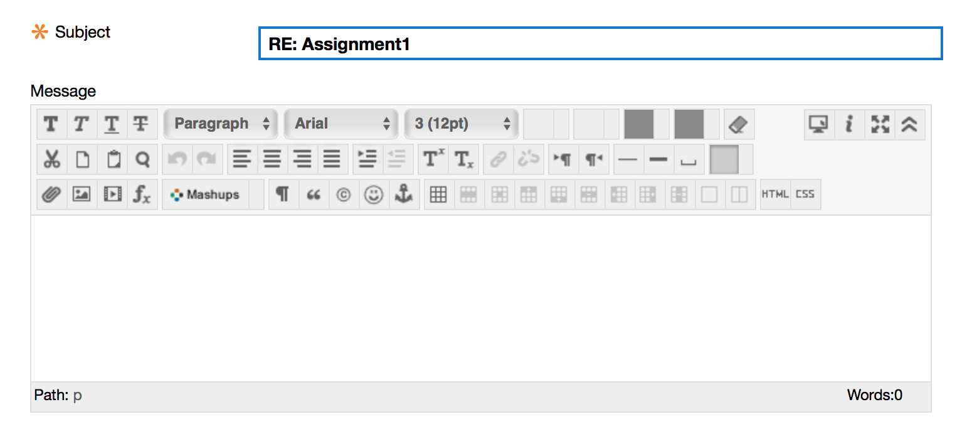
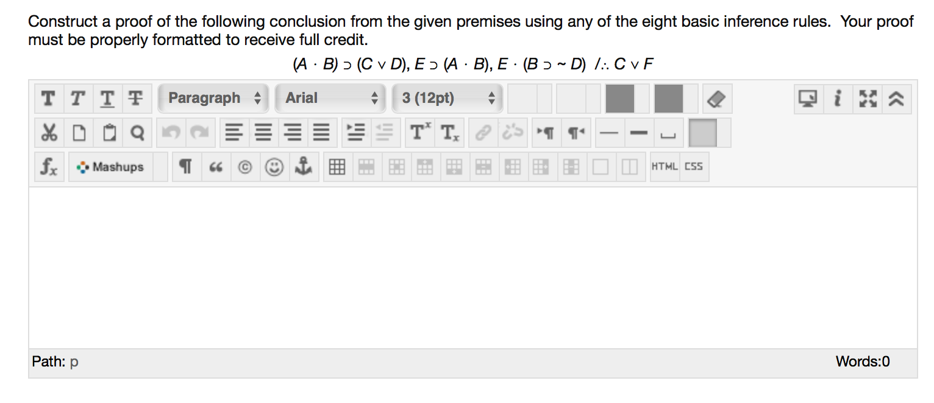
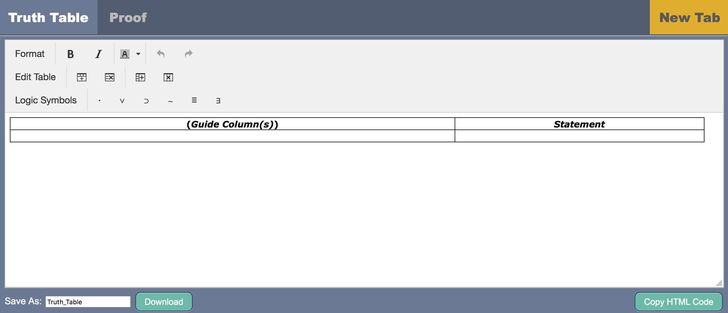
Client: Professor Eric Hatleback
Users: Students of PHIL 500 Introduction to Logic
Problem: the interface of Course Web for typing logic notation is not efficient
Main function: a convenient logic editor could be used in assignment and quiz

Slide 4
User Study

Slide 5
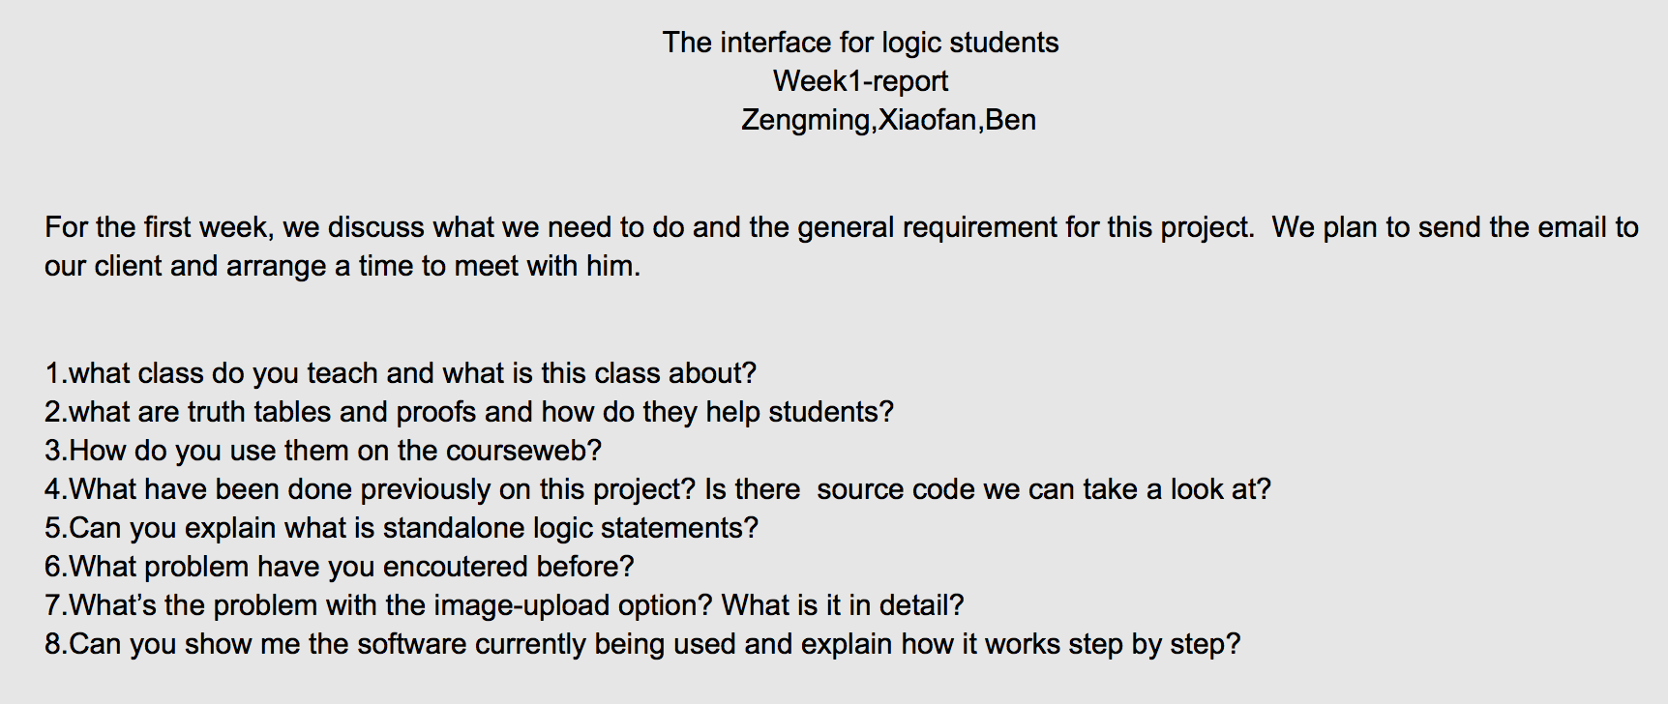
Client Interview

Slide 6
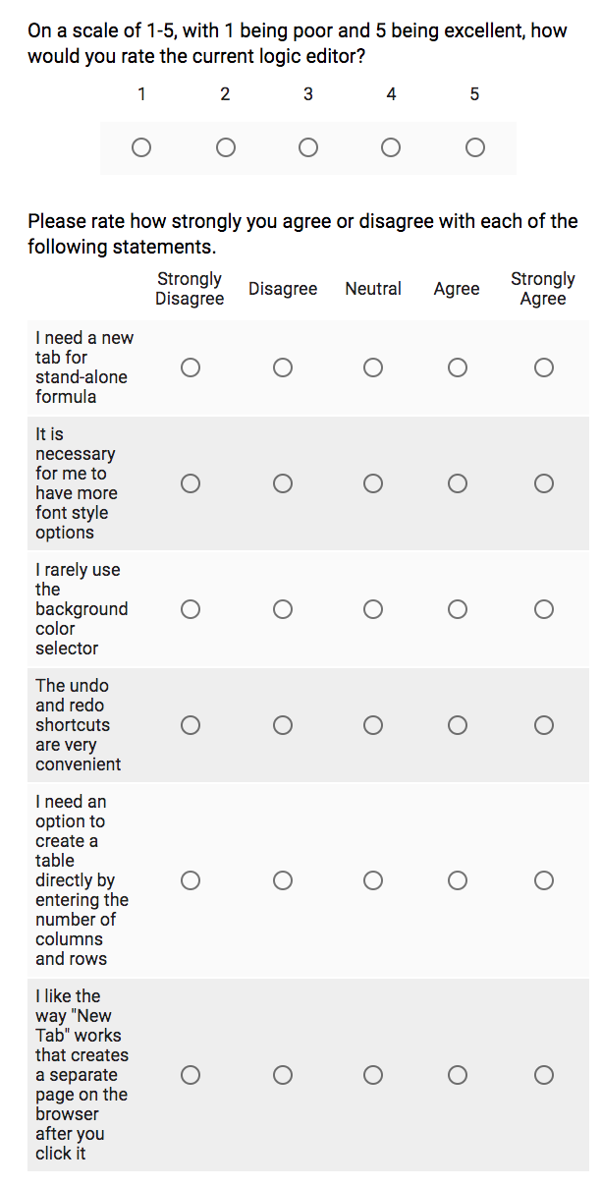
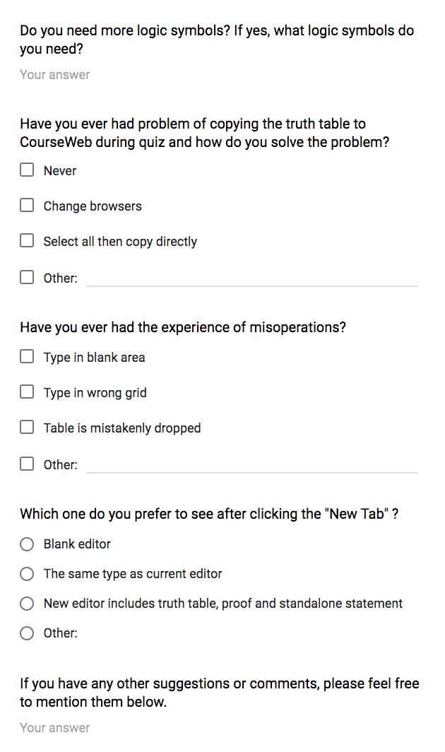
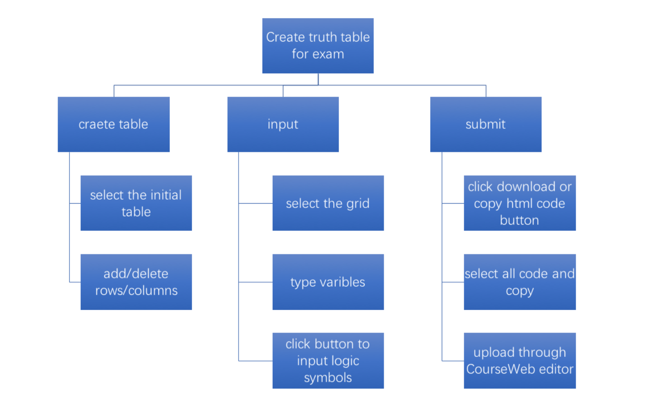
Questionnaire Survey
Task analysis

Slide 7
Initial Design

Slide 8
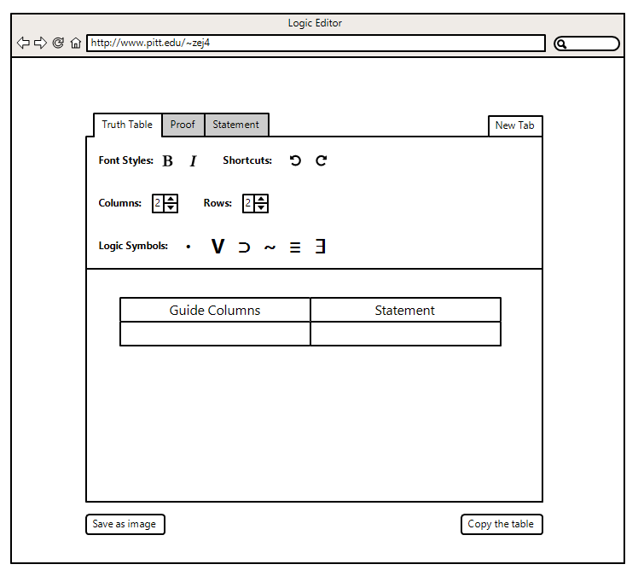
New Functions
Wireframe Design
Create table
Shortcuts
Copy table to CourseWeb
Dynamic new tab

Slide 9
Application
Building

Slide 10
Basic Content:
Html, CSS, JavaScript, tinyMCE
Engineer Structure:
Index
WEB-INF
web.xml
JS
JQuery
Plugin
tinyMCE
html2canvas
SaveorCopy

Slide 11
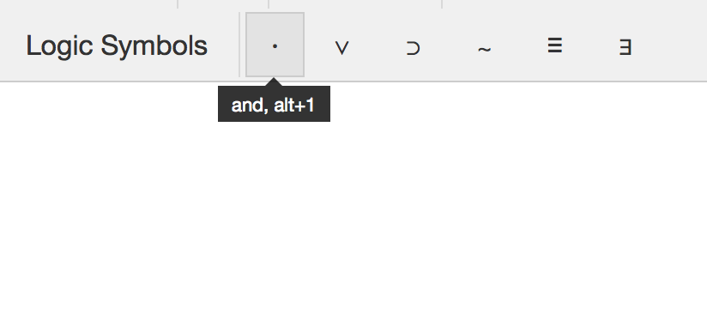
New Functions
Function View
Shortcuts for logic symbols

Slide 12
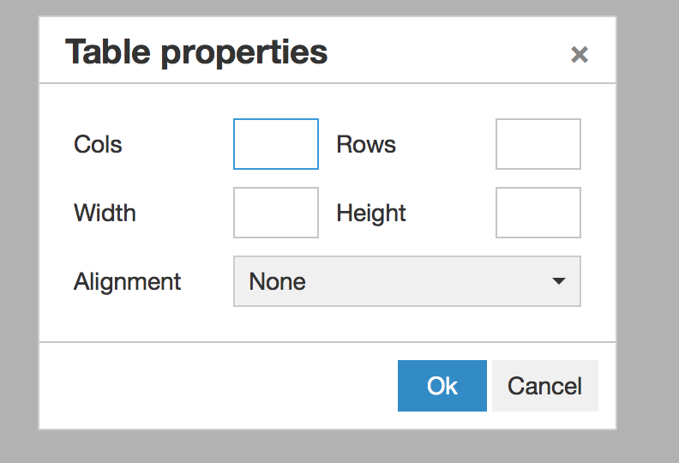
New Functions
Function View
A new way to insert table

Slide 13
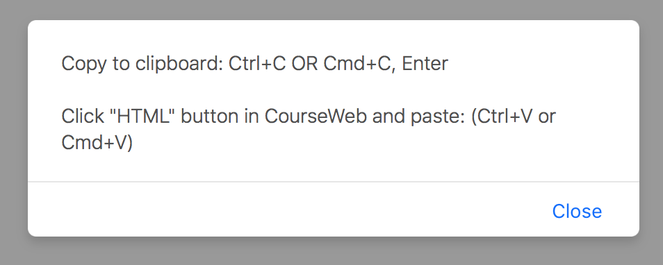
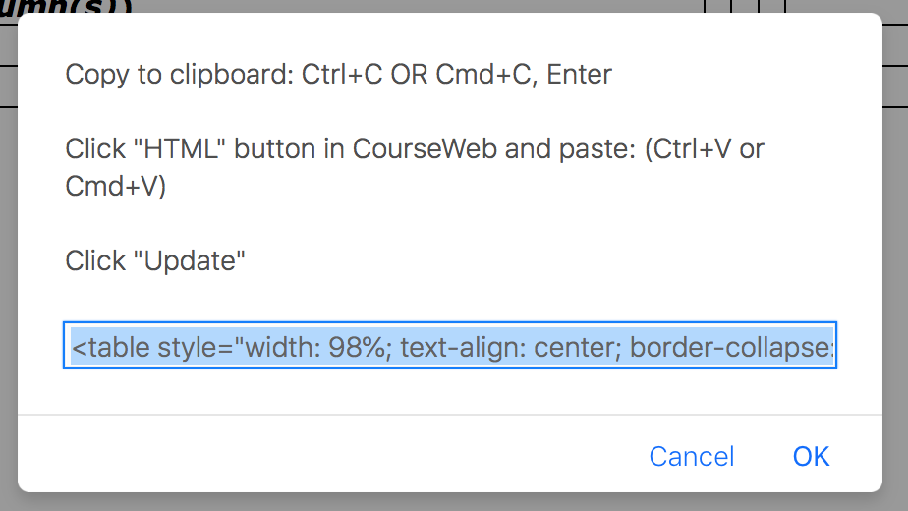
New Functions
Function View
New solution to copy table

Slide 14
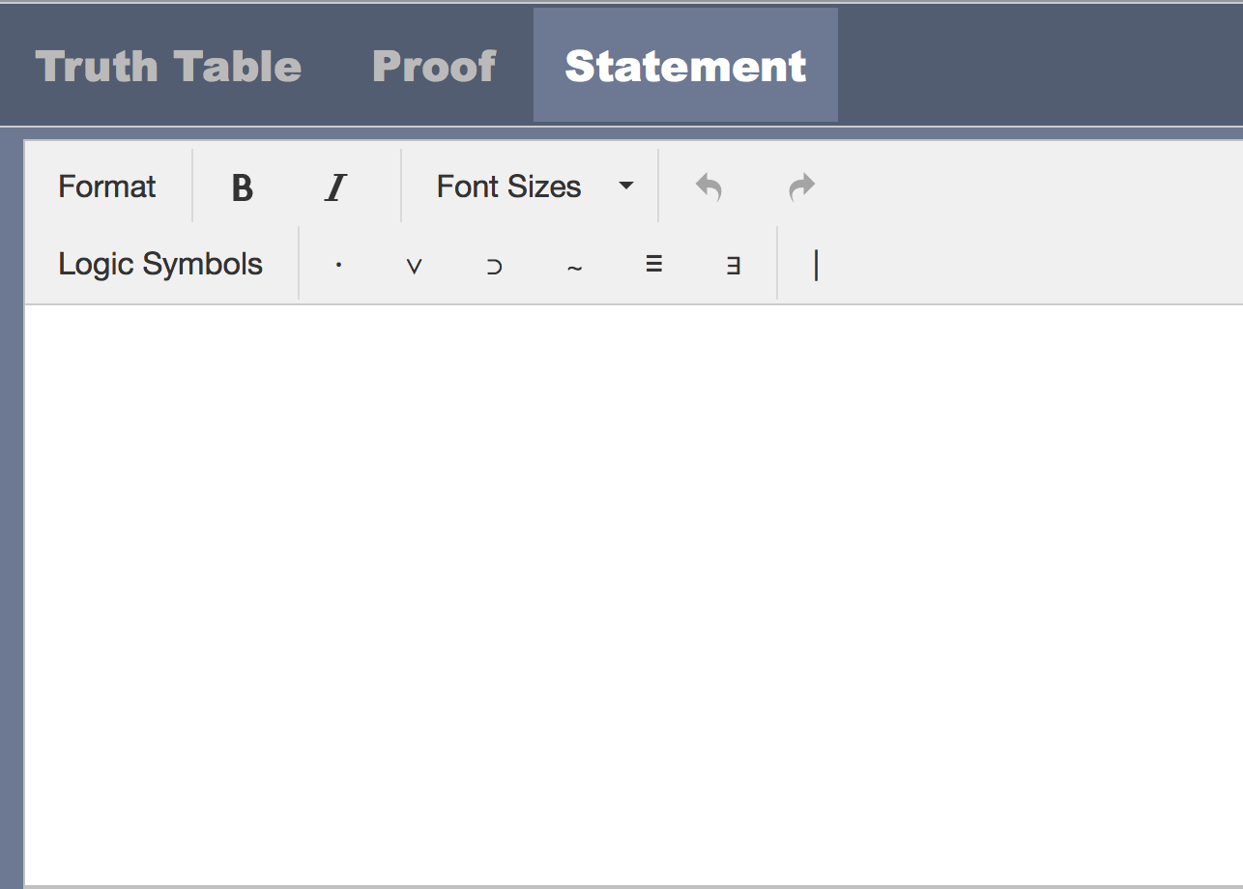
New Functions
Function View
New tab for statement

Slide 15
Summary
https://youtu.be/Zui2XssuFr0
The final logic editor realizes all basic users' requirements which include the ability to generate standalone logic statements, an alternate solution for the image-upload option, additional ease-of-use options. But there are some minor disadvantages, we didn't realize to add a new tab in the current page, and image save function still has a bug when the statement is too long. And because of the conditions, users study doesn't take a long time this time, the user experience could be better.

Slide 16
Thank you

